Slide 1


Slide 2
Introductions
Co-Organizers
Brian Jablonsky

Slide 3
News
Follow us on Twitter: @NYCDotNetDevs
BUILD 2022 - https://bit.ly/3nlIGqm
.NET 7 Preview 5 - https://bit.ly/39Y4xBa
.NET MAUI GA - https://bit.ly/3OITMkL
ASP.NET Migration Tooling - https://bit.ly/3bkXL8K

Slide 4
Other NYC Meetings
TBA – NYC Mobile .NET “TBD” (https://www.meetup.com/nycmobiledev/)
Thursday, July 21st – NYC PowerShell Meetup “Deploy your Azure Functions the DevOps way” (https://www.meetup.com/NycPowershellMeetup/)
Thursday, July 28th – Microsoft Reactor NY “Reactor Relaunch” (https://www.meetup.com/microsoft-reactor-new-york/events/286702498/)

Slide 5
.NET Virtual User Group
https://dotnetfoundation.org/community/virtual-user-group
Attend another .NET User Group virtually!
Constantly adding new user group meetings
Replay some of the meetings you might have missed

Slide 6
Upcoming Meetings
Thursday, July TBD – TBA

Slide 7
Announcements
Call for presentations!
Have an idea/topic for a presentation?
Want to give a presentation?
Brian (brian@nycdotnetdevs.com), or tweet @NYCDotNetDevs

Slide 8
Announcements
State of User Group Survey
We’ll be sending out a survey via Meetup to gauge your interest in what you want to see from the user group
Submit your survey anonymously, or add an email address and be entered to win some prizes ($25 Amazon gift cards, .NET merch, JetBrains licenses, etc)

Slide 9

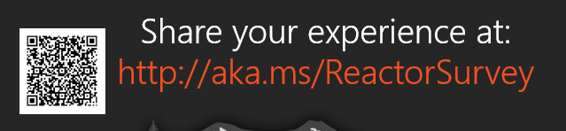
Sponsors
Microsoft Reactor http://microsoftreactor.com
Microsoft Reactors are developer community hubs providing technical events, community networking, and collaboration. They are graciously sponsoring our group in 2019 by providing our meeting space and food! Please fill out the survey at the end of the meeting!

Slide 10

Sponsors
JetBrains https://jetbrains.com
For over 15 years, JetBrains has strived to make the strongest, most effective developer tools on earth. By automating routine checks and corrections, JetBrains tools speed up production, freeing developers to grow, discover and create.

Slide 11

Layla Porter
https://twitter.com/LaylaCodesIt
Creator of Women Of DotNet
Twitch Coder
Microsoft MVP
GitHub Star
VMWare Tanzu Advocate

Slide 12

Reactor NYC
@MSFTReactor
#ReactorNYC
How was your Meeting?

Slide 13

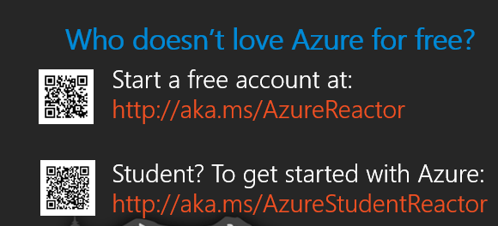

Reactor NYC
@MSFTReactor
#ReactorNYC

